Slide 1
CGB1201 – JAVA PROGRAMMING
Department of Artificial Intelligence and Data Science
Academic Year: 2024 – 2025 (Odd Semester)
Register Number : 2303811724321079
Name : OM PRAKASH M
Year : II
Semester : III
Section : B
Date :03/12/2024

Slide 2
Title of the Project
ONLINE VOTING SYSTEM

Slide 3
Problem Identification
Traditional voting systems face several challenges, including logistical inefficiencies, high costs, and potential security risks such as vote tampering and fraud. Manual processes often lead to delays in vote counting and result announcements. Additionally, accessibility can be an issue for voters in remote locations or those with physical limitations. Ensuring voter privacy and data integrity is also a major concern. This project addresses these issues by leveraging a secure, online platform to facilitate transparent, efficient, and accessible elections while maintaining data security and user authentication. The system also aims to reduce human error and enhance voter participation through a streamlined digital process.

Slide 4
Objective
The primary objective of the Online Voting System is to provide a secure, transparent, and user-friendly platform for conducting elections digitally. It aims to ensure data integrity, voter privacy, and accessibility by leveraging secure authentication methods and encryption. The system seeks to automate vote collection, counting, and result generation, reducing human error and enhancing efficiency. Additionally, it promotes wider voter participation by offering a convenient, remote voting option and ensuring fair and tamper-proof elections. The project also aims to streamline administrative tasks, such as managing voter and candidate records, through an intuitive dashboard.

Slide 5
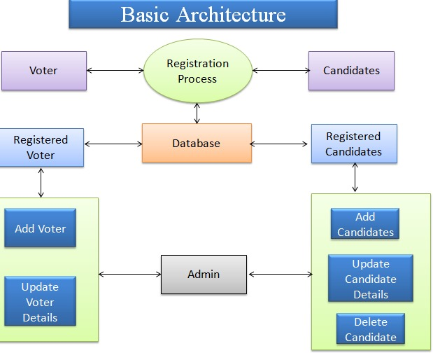
Proposed Architecture

Slide 6
Java Programming - Concepts Used
Object-Oriented Programming (OOP): Classes and objects are used to model users, candidates, and voting processes, allowing modularity and reusability of code.
Exception Handling: Ensures smooth functioning by managing errors like invalid user input, database connectivity issues, or authentication failures without crashing the application.
File Handling and Serialization: Securely stores and retrieves user and vote data, ensuring persistence and confidentiality during operations.
Multithreading: Improves performance by handling multiple user requests simultaneously, particularly during high-traffic election periods.
Database Connectivity (JDBC): Manages interactions with the database, including user registration, authentication, and vote storage, ensuring data integrity and security.

Slide 7
List of Modules
User Registration Module
Authentication and Login Module
Voting Module
Candidate Management Module
Voter Management Module
Result Calculation and Display Module
Notification Module

Slide 8
Module Description
User Registration Module: Allows voters and candidates to register with their details, such as name, email, and voter ID. Ensures validation through OTP and email verification to maintain user eligibility.
Authentication and Login Module: Verifies user login with credentials, including username and password. Adds security layers with CAPTCHA and OTP to prevent unauthorized access.
Voting Module: Authenticated voters can view candidates, select their choice, and submit their vote. Ensures votes are encrypted and users can only vote once during the election.
Candidate Management Module: Admins can add, update, or delete candidate profiles as needed. Ensures a properly maintained and valid candidate list for the election.

Slide 9
Module Description (Cont..)
Voter Management Module: Allows admins to manage voter records, including adding or updating details. Ensures an accurate and clean voter database for reliable elections.
Result Calculation and Display Module: Automatically tallies votes and displays results, including percentages and rankings. Stores the results securely for future reference and analysis.
Notification Module: Sends notifications to users about registration, voting, and election deadlines. Admins receive alerts about system activities like new registrations or vote submissions.

Slide 10
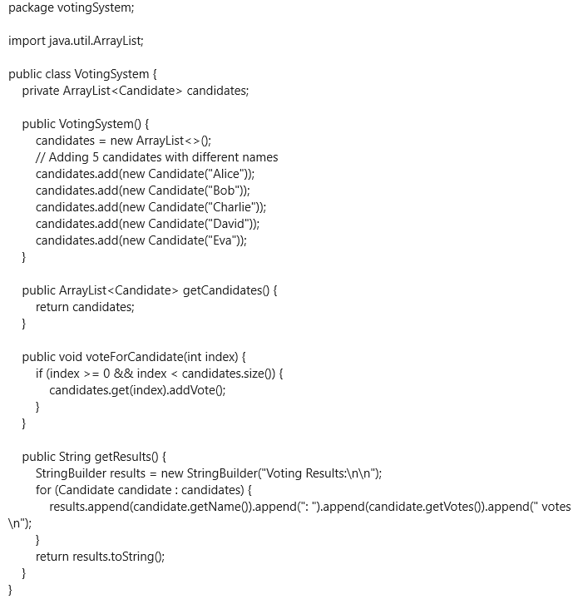
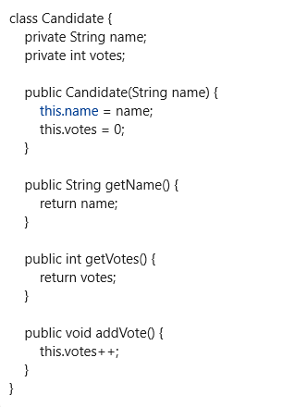
Source code

Slide 11
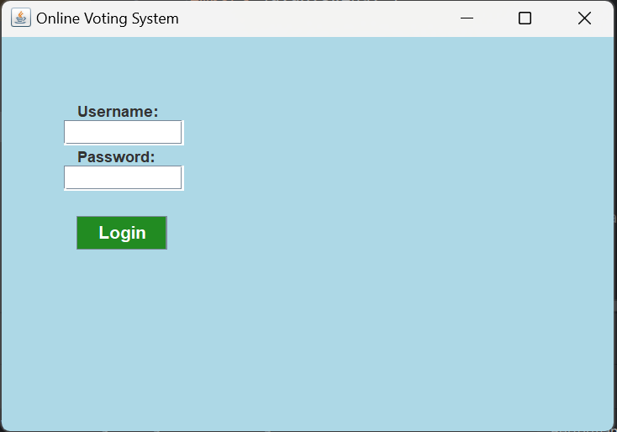
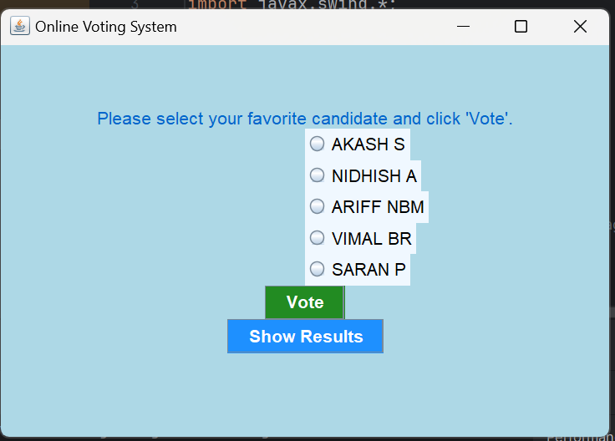
Results
1.LOGIN PAGE : 2. CANDIDATE LIST :

Slide 12
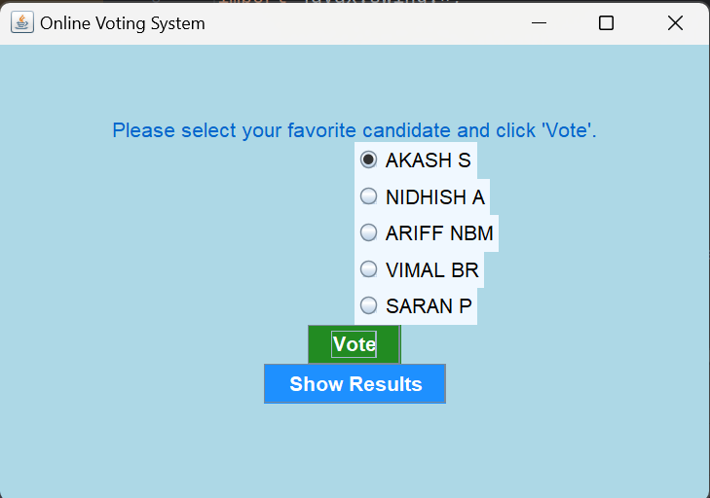
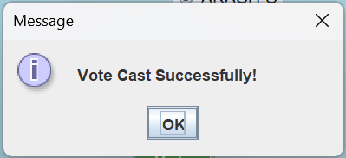
Results
3. CANDIDATE SELECTION : 4. VOTE STATUS :

Slide 13
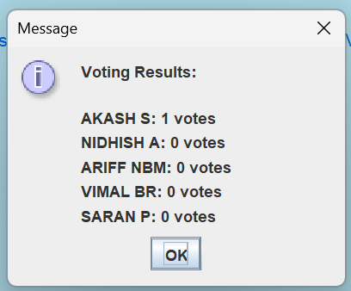
Results
5. RESULT PAGE :

Slide 14
Conclusion
The Online Voting System demonstrates a secure, efficient, and reliable platform for conducting elections in a digital environment. By integrating user-friendly interfaces, robust authentication mechanisms, and advanced encryption techniques, the system ensures the confidentiality, integrity, and accuracy of the voting process. Its ability to manage voter registrations, authenticate users, facilitate secure voting, and display results transparently highlights its effectiveness in addressing key challenges such as data security, single-vote integrity, and scalability. The system also streamlines election management through an admin dashboard and notification features, enhancing communication and oversight for both users and administrators. The successful implementation and testing of this system show its potential to replace traditional voting methods, offering a modern and scalable solution suitable for real-world applications.

Slide 15
Thank You
Any queries???

